Slide 1
Lecture 3 Debugging R code
Kristin Privitera-Johnson
FISH 553 Advanced R
School of Aquatic and Fishery Sciences
University of Washington

Slide 2

Background readings
RStudio debugging https://support.rstudio.com/hc/en-us/articles/205612627-Debugging-with-RStudio
Hadley Wickham, Advanced R book http://adv-r.had.co.nz/Exceptions-Debugging.html
Sean Anderson blog post http://seananderson.ca/2013/08/23/debugging-r.html

Slide 3
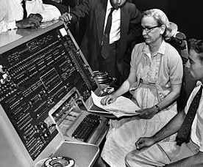
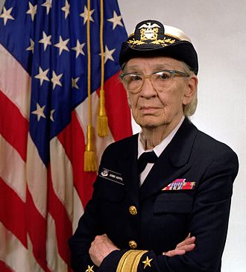
Why “debugging”?
9 September 1947. Technicians working on
a Mark II computer in Harvard discovered a moth stuck in one of the relays and causing errors in the computer. On reporting the problem to Admiral Grace Hopper, she remarked that they were “debugging” the computer.
¹The first published mention was in 1878 so it was co-opted by computer science. The first computer science publications were in 1952, and one was coauthored by Metropolis of Bayesian MCMC algorithm fame.
²Also known as “Amazing Grace”, Grace Hopper was a Rear Admiral in the U.S. Navy, and among other things invented the idea of a machine-independent programming language, created the first compiler, and helped develop COBOL, the first and most widespread of all modern programming languages
More complete story: Shapiro FR (1987) Etymology of the computer bug: history and folklore. American Speech 62:376-378
Notes:
Wikimedia commons: http://en.wikipedia.org/wiki/File:Grace_Hopper_and_UNIVAC.jpg
http://en.wikipedia.org/wiki/Debugging
http://en.wikipedia.org/wiki/Admiral_Grace_Hopper

Slide 4
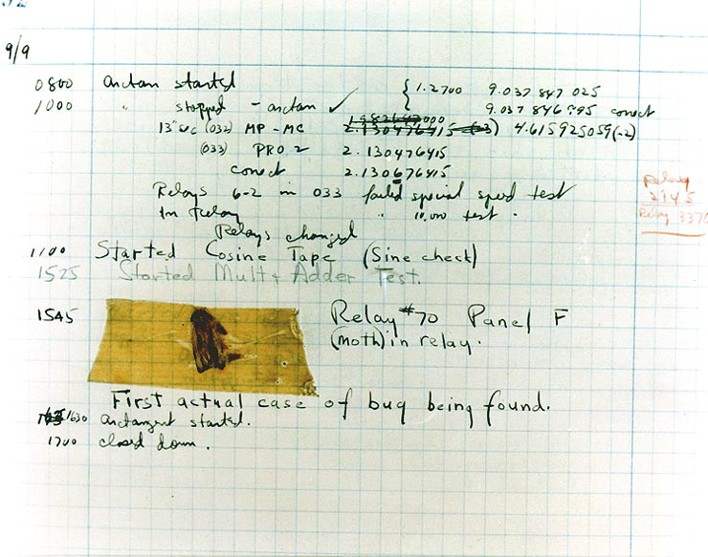
Source: http://commons.wikimedia.org/wiki/File:H96566k.jpg
Notes:
http://commons.wikimedia.org/wiki/File:H96566k.jpg
Description The First "Computer Bug" Moth found trapped between points at Relay # 70, Panel F, of the Mark II Aiken Relay Calculator while it was being tested at Harvard University, 9 September 1947. The operators affixed the moth to the computer log, with the entry: "First actual case of bug being found". (The term "debugging" already existed; thus, finding an actual bug was an amusing occurrence.) In 1988, the log, with the moth still taped by the entry, was in the Naval Surface Warfare Center Computer Museum at Dahlgren, Virginia, which erroneously dated it 9 September 1945. The Smithsonian Institute's National Museum of American History and other sources have the correct date of 9 September 1947 (Object ID: 1994.0191.01). The Harvard Mark II computer was not complete until the summer of 1947.
Removed caption read: Photo # NH 96566-KB First Computer "Bug", 1945
Date9 September 1947SourceU.S. Naval Historical Center Online Library Photograph NH 96566-KNAuthorCourtesy of the Naval Surface Warfare Center, Dahlgren, VA., 1988.

Slide 5
Debugging is scientific
Hypothesis: If I execute this line of code, then variable A will change from value x to value y
Method: create an observation to report the value of A, then run the line of code
Results: is A = y?
Discussion: If A == y, then we move to our next investigation. A != y then you have found the bug (or your hypothesis is wrong)

Slide 6
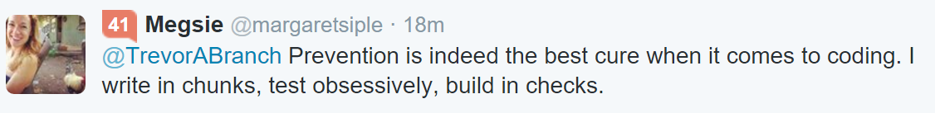
DEFENSIVE programming
Anything that can go wrong, will—at the worst possible moment Finagle’s Law, coined by John W. Campbell Jr.
To reduce debugging time, check every line of code you write, as soon and often as you can
Find a way of testing if it looks right
Write a line or two before testing it
Write function stubs (that just return a number) before fleshing them out [top-down programming]

Slide 7
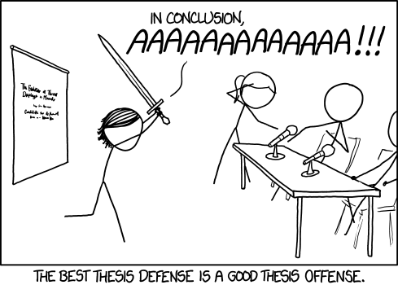
https://xkcd.com/1403/
Notes:
Mouseover text: MY RESULTS ARE A SIGNIFICANT IMPROVEMENT ON THE STATE OF THE AAAAAAAAAAAAAAAART

Slide 8
Debugging methods
Defensive coding avoids errors in the first place
Trial and error
Make your function global
Using print() or cat() statements
The functions traceback(), browser() and exit on error using options()
RStudio v0.98: breakpoints, the most elegant solution of all

Slide 9
Trial and error
Code fails
Change something based on error message: try again
It still fails!
Repeat process until….
Discover the typo/logical error, correct it, try again
Code may fail due to other changes you made...
This is often more difficult when debugging a function
For simple code that you know well (e.g., you just wrote it), this often works.

Slide 10
Debug a function: Make it global
func <- function(x) {
y <- 2*x^2
return(y)
}
func(x=3)
x <- 3
y <- 2*x^2
print(y)
y <- (2*x)^2
print(y)
Variables inside functions are not available outside functions, so you can’t inspect their values directly
Value of every variable is visible, but variables are global now. Instead, I usually start with lines of code and once I have tested each line, I convert the code into a function.

Slide 11
Liberal use of print() or cat()
Function calls
read.data <- function() {
print("inside read.data()")
}
plot.fig <- function() {
print("inside plot.fig()")
}
main <- function() {
print("before read.data()")
read.data()
print("before plot.fig()")
plot.fig()
print("before return")
return(34)
}
Results
> main()
[1] "before read.data()"
[1] "inside read.data()"
[1] "before plot.fig()"
[1] "inside plot.fig()"
[1] "before return"
[1] 34
This method is called top-down programming: setting up function stubs that call other functions, before fleshing out the functions.

Slide 12
Creating your own error messages
Sometimes you want to create code that is bullet-proof, for example if handing your code to a new R user or publishing your own R package.
It may seem obvious to you that your code can only handle positive integers, but the user may give it a text string, a real number, or a negative number
The stop() command creates an error message
func1 <- function(x) {
if (x < 0) {
stop("x needs to be a positive integer")
}
return(sqrt(x))
}
paste() and paste0()

Slide 13
In-class exercise 1 “3 code to debug 1.r"
fact2 <- function(n) {
result <- 1
for (i in n:2) {
result <- result*i
}
return(result)
}
> fact2(4) #4*3*2*1 = 24
[1] 24
> fact2(1) #should be 1
[1] 2
> fact2(0) #should be 1
[1] 0
The function on the left is meant to mimic the R factorial() function. It works fine for positive integers 2, 3, ... but not for 0, 1, or negative numbers.
To do: debug the code, and add a sensible error message using stop().

Slide 14
Using traceback()
R will tell you in which function the error occurred, but with complicated function nesting it may not be obvious
When an error occurs, an internal variable called .Traceback stores all the function calls that were executed before the error (it is empty if there was no error)
Running the function traceback() immediately after the error will show the sequence of functions leading up to the error
This is useful particularly when you are not familiar with the code and how functions call each other

Slide 15
Using browser() and options() If you use Rstudio, breakpoints are a better method
Add a browser() command somewhere in your code, and it will stop executing at that point and...
Type in an object name to see its value
Type n to go to the next line in the function
Type <enter> to continue running the code as normal, until another browser() command is encountered
Type Q <enter> to exit the browser altogether
Adding options(error = recover) before the code is the same as adding browser() at the first error
Adding options(warn = 2) is the same as adding browser() at the first warning message

Slide 16
RStudio breakpoints
Set a point in your code called a “breakpoint” and your code will run to that point and stop and you can inspect the values
RStudio 0.98 includes breakpoints
must run entire file (source button)
shift+F9 add/remove breakpoint at the cursor position
runs until it hits a breakpoint
then F10 steps through the code one line at a time showing all the object values inside the function
shift+F5 runs to the next breakpoint
more options under Debug menu

Slide 17
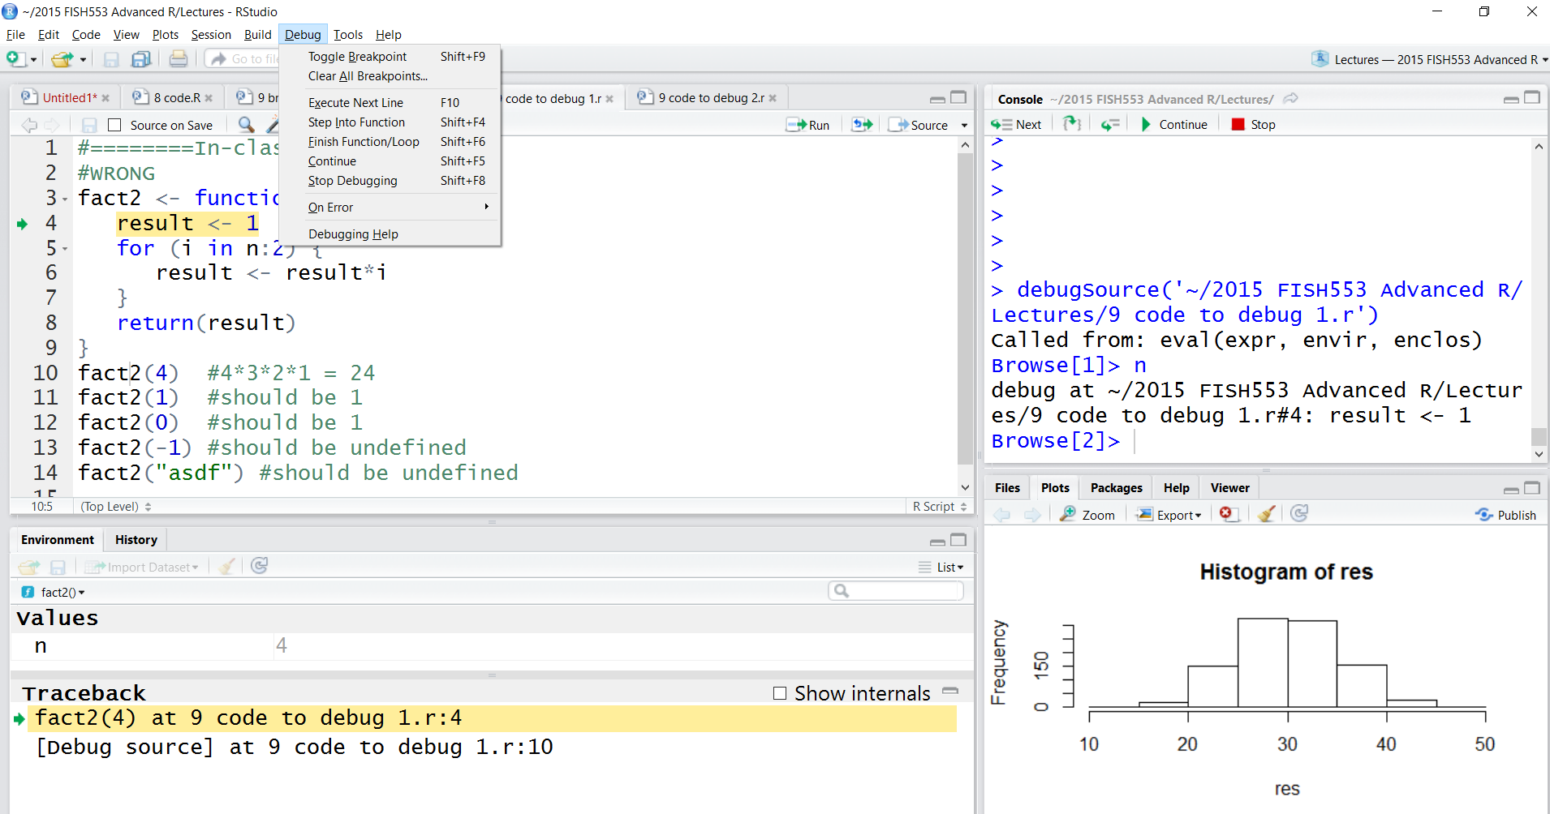
RStudio breakpoints

Slide 18
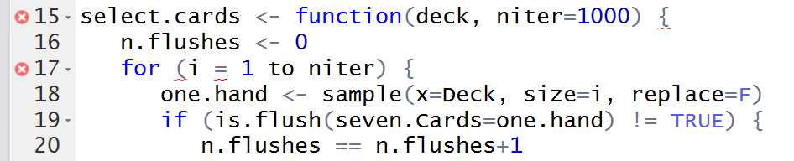
RStudio auto-detection of errors
The little x on the left tells you that there is an error in the function select.cards()
There is also an error on the second line within the function

Slide 19
Demo: setting a breakpoint in line 4 of “3 code to debug 1.r"

Slide 20
In-class exercise 2 “3 code to debug 2.r"
is.flush <- function(seven.cards) {
return(table(seven.cards) >= 5)
}
select.cards <- function(deck, niter=1000) {
n.flushes <- 0
for (i = 1 to niter) {
one.hand <- sample(x=Deck, size=i, replace=F)
if (is.flush(seven.Cards=one.hand) != TRUE) {
n.flushes == n.flushes+1
}
return(n.flushes)
}
}
#create deck of 52 cards, 13 in each suit
deck <- rep(c("Clubs", "Diamonds", "Hearts",
"Spades"), times=12)
select.cards(deck=Deck, niter=1000)
In poker, a flush occurs when you have five cards
all of the same suit (clubs, diamonds, hearts, spades). This code is meant to repeatedly select 7 cards at random and return the number of times that 5 (or more) are the same suit. However, it is riddled with bugs and needs debugging.
(Answer: about 20-40 times out of 1000 you will get a flush.)

Slide 21
Debugging method | When to use
 | Defensive coding | before coding/while coding; stop(): use paste() & paste0()
 | Trial and error | simple code you know well; not in a function
 | Global functions | writing simple functions
 | print() or cat() | always; especially inside nested functions
 | traceback() | long scripts with multiple functions
 | browser() or options() | when not using RStudio; if you know the region of your bug
 | Breakpoints | RStudio; same as traceback() and browser() but easier to use

